Slide 1
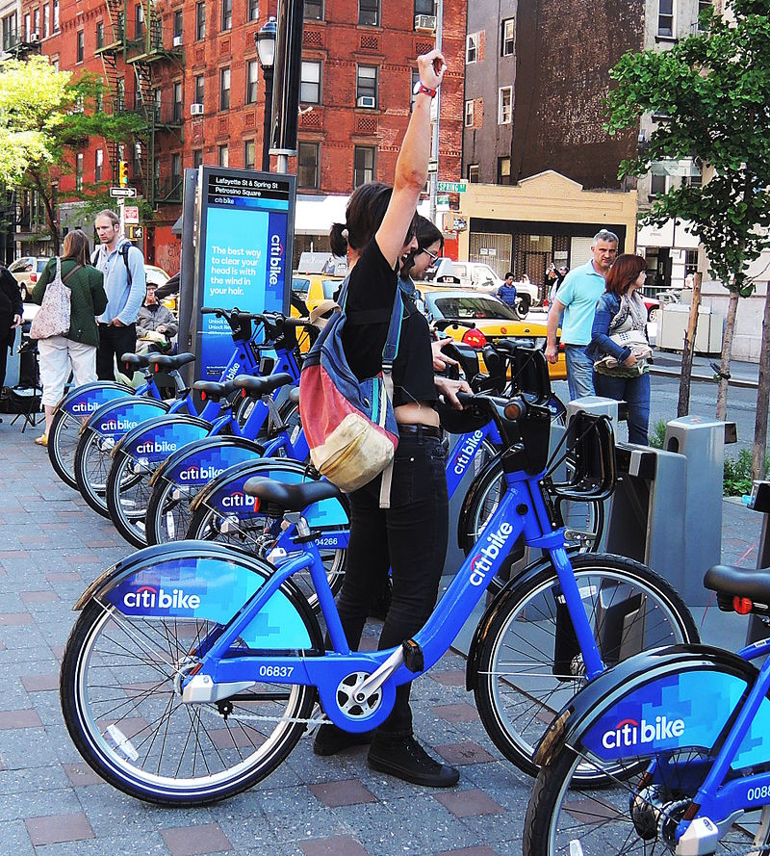
Citibike Tableau Challenge

Slide 2
Using Citi bike database we analysed the data from the December 2022 to January 2023.
We want to study whether Holiday season affected Citi bike rides
We found that there is an increase of Citi bike rides on January compared to December
We see a shift in bottom drop off stations on December compared to January

Slide 3
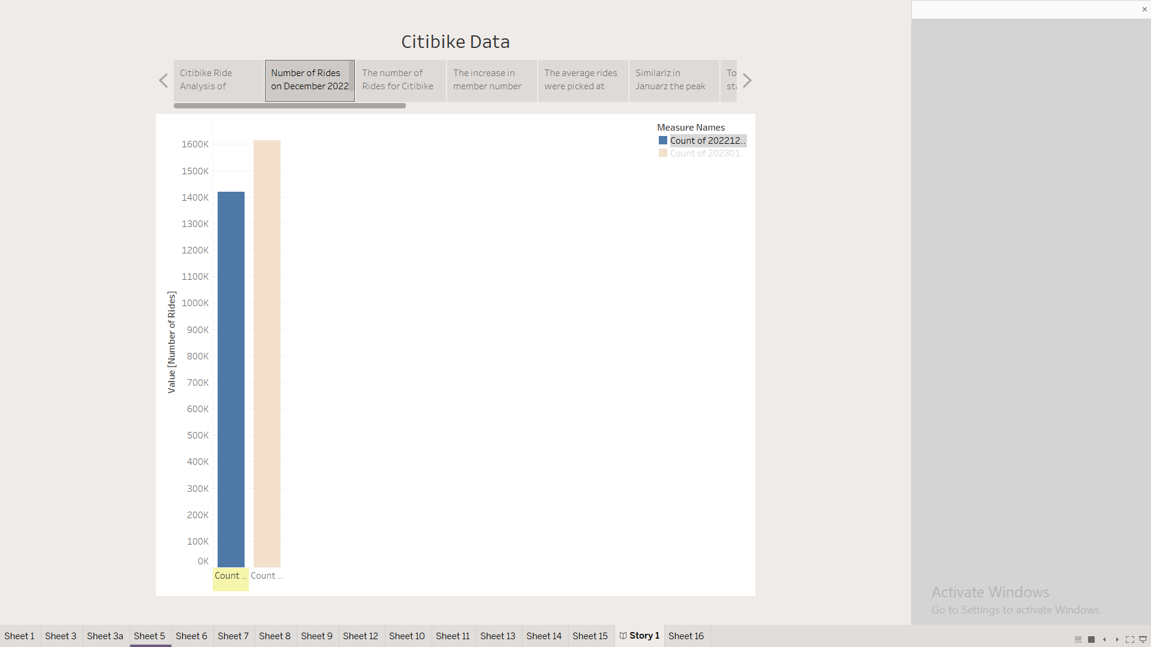
Total number of rides is increased on January

Slide 4
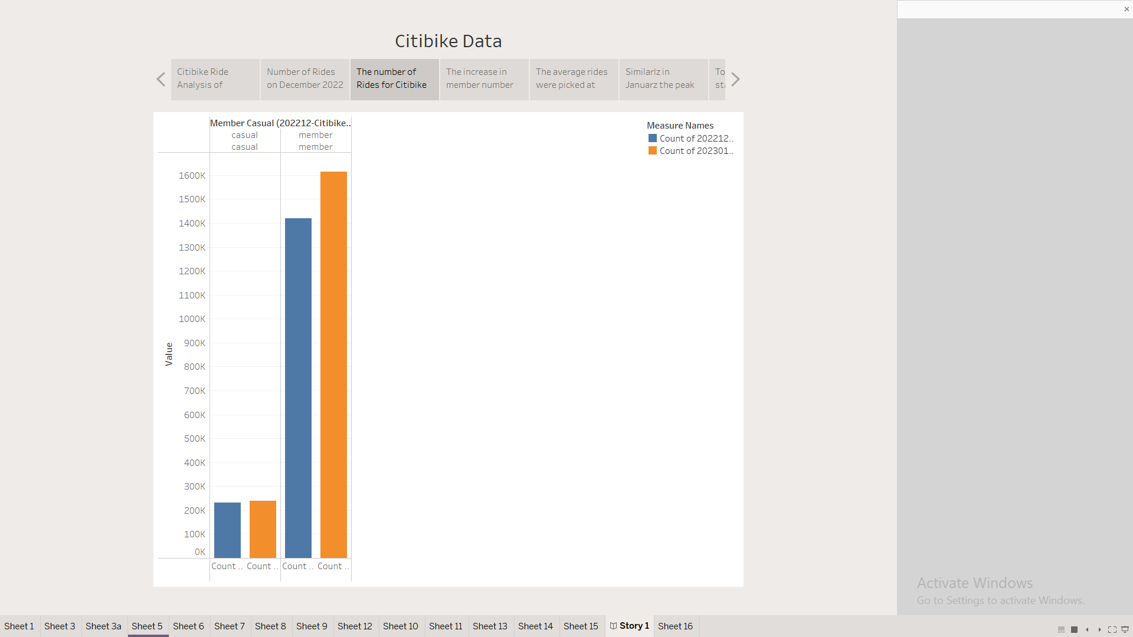
Citi bike members taking more rides on January than December

Slide 5
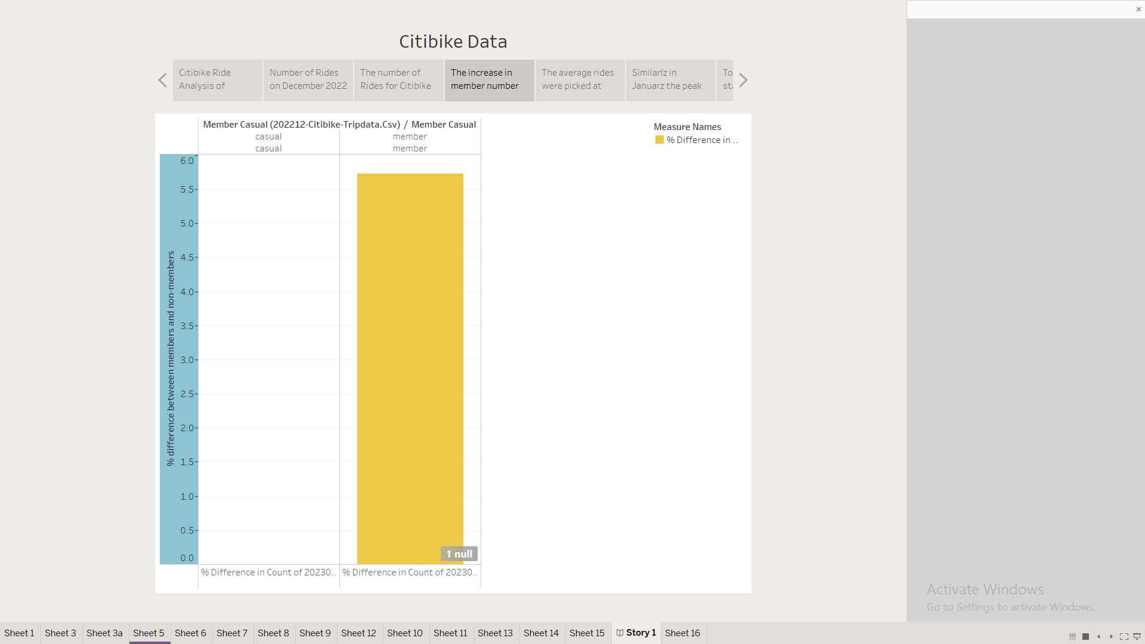
This increase is 5.76%

Slide 6
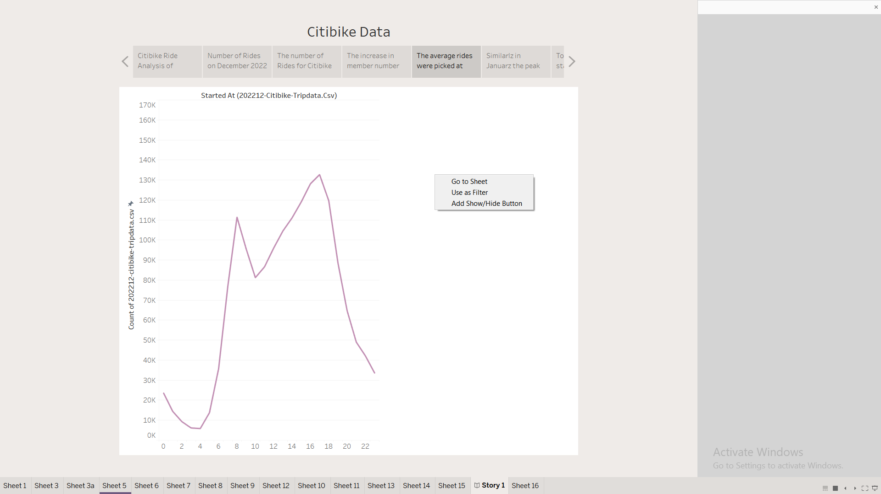

Slide 7
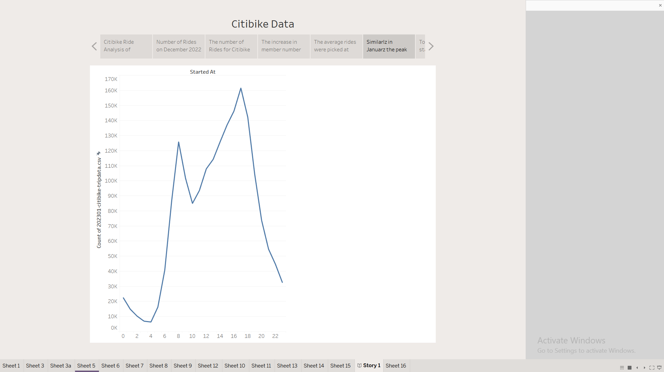
Peak pick up hours are 7.00 am and 5.00pm and are increased on January

Slide 8
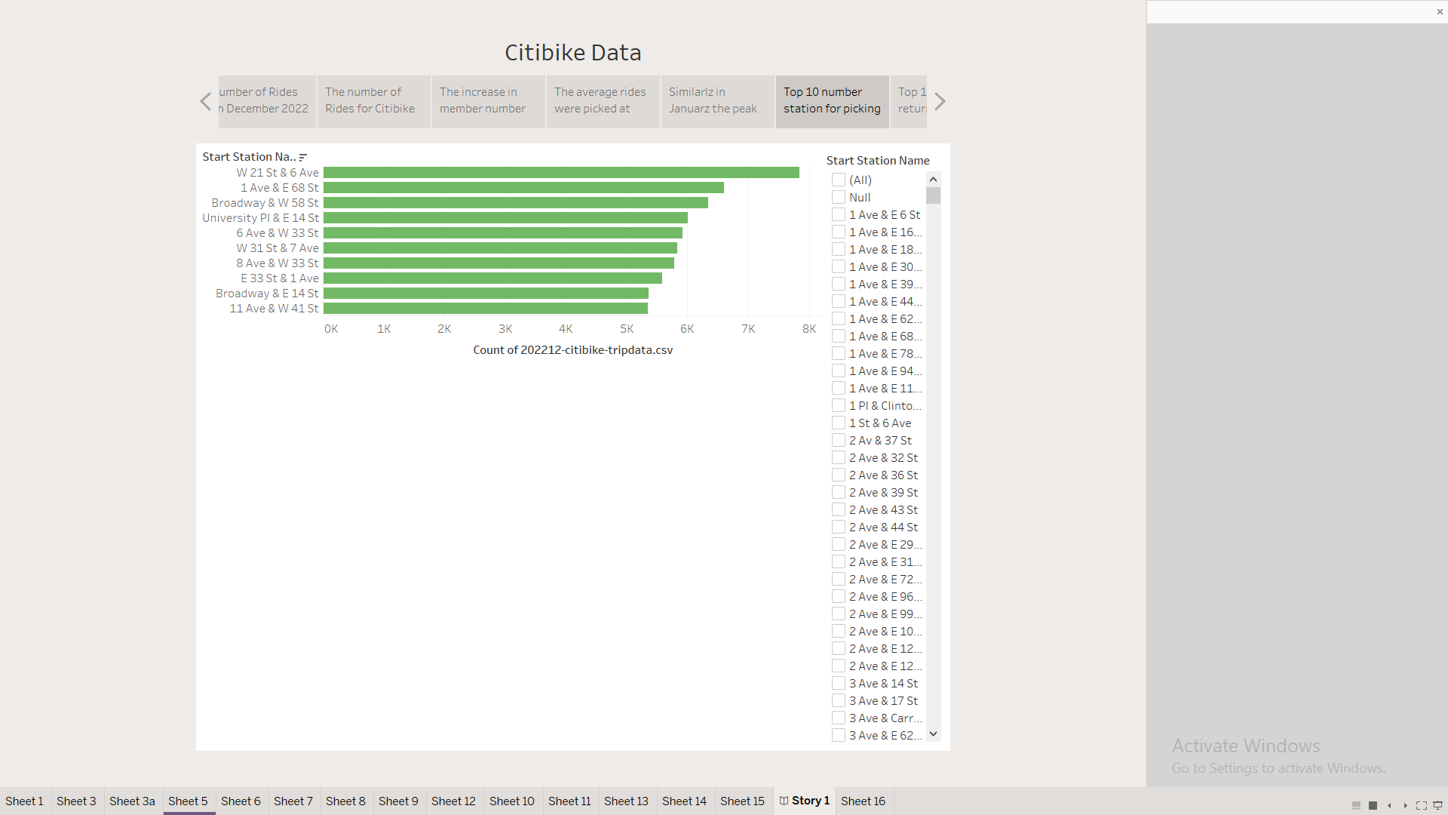

Slide 9
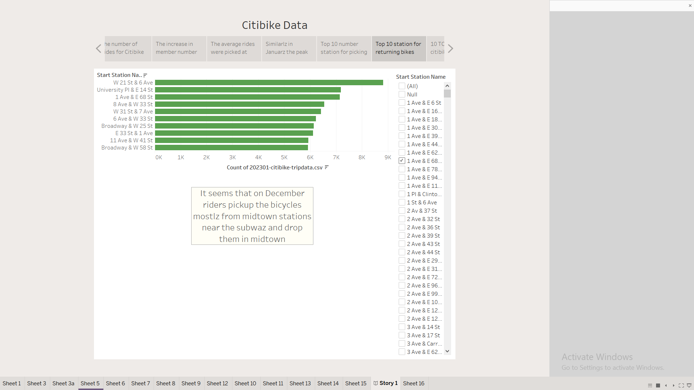

Slide 10
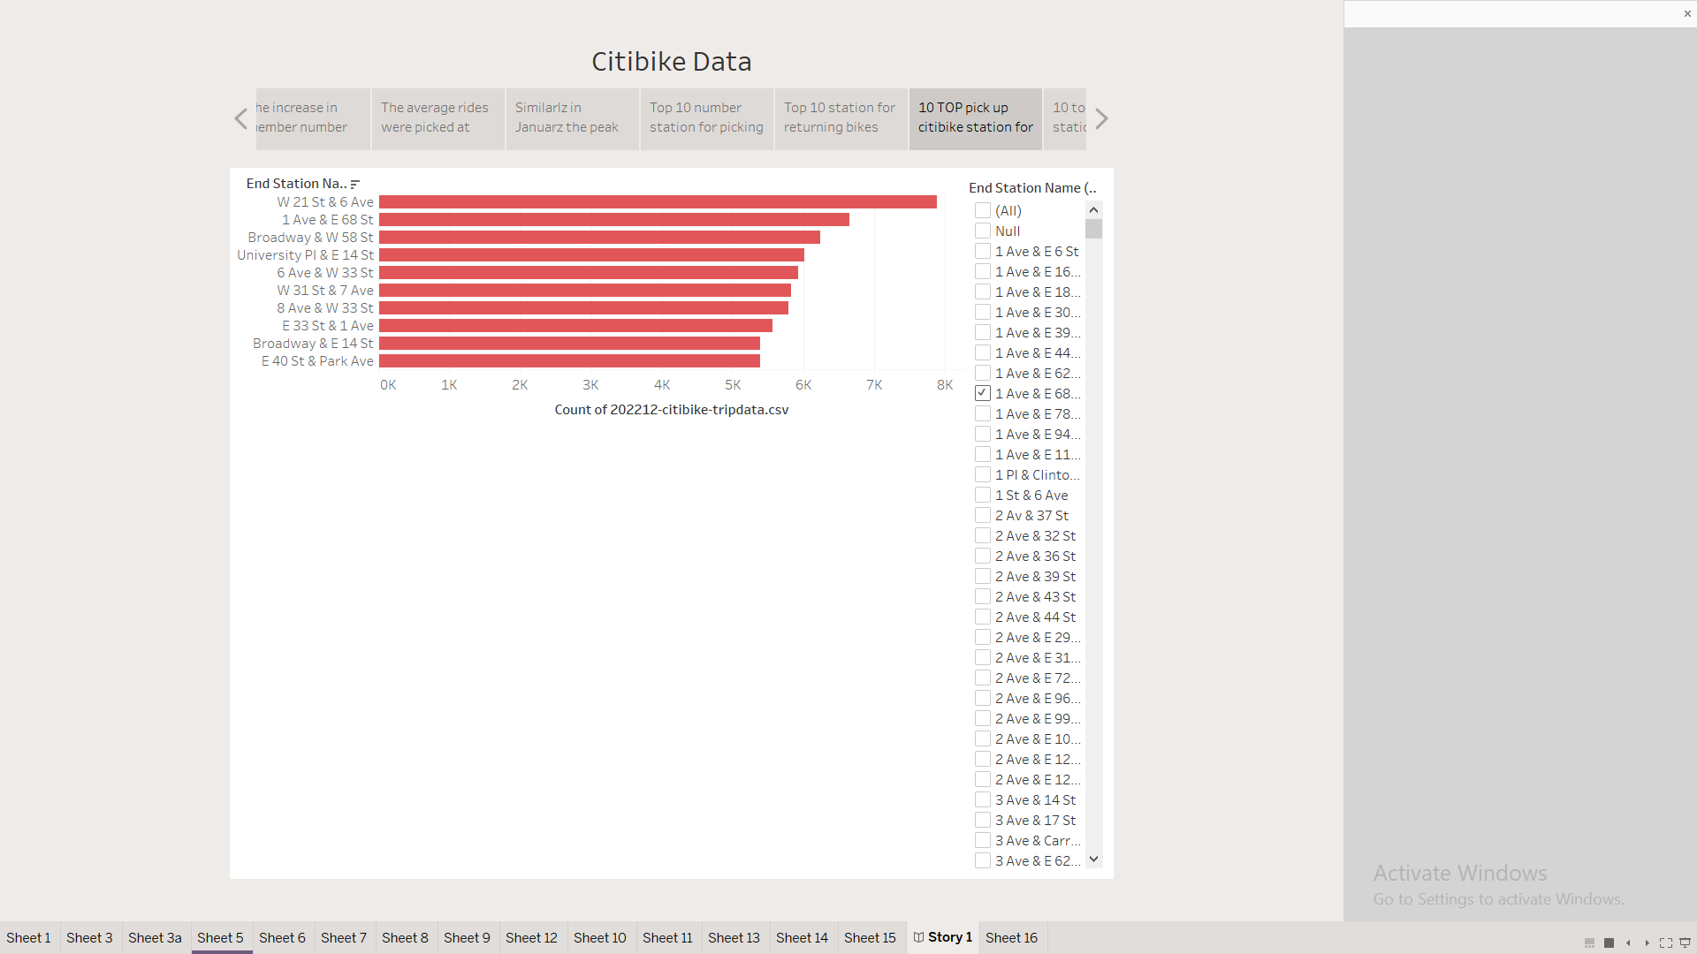

Slide 11
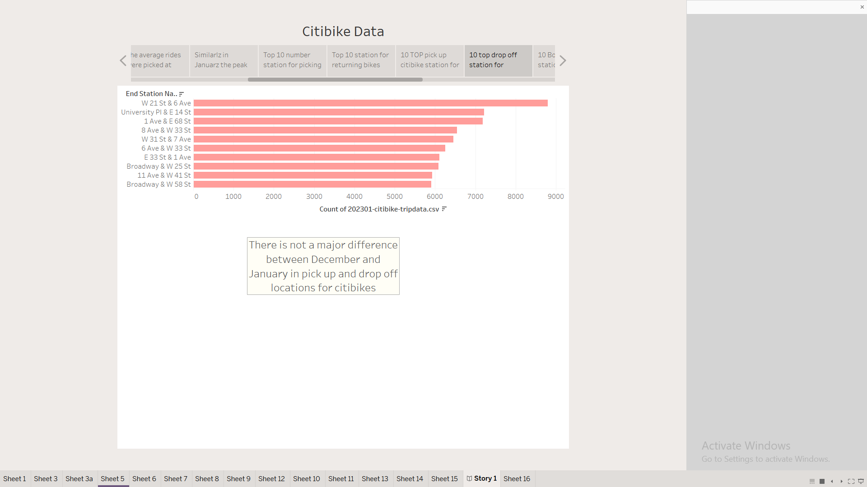

Slide 12
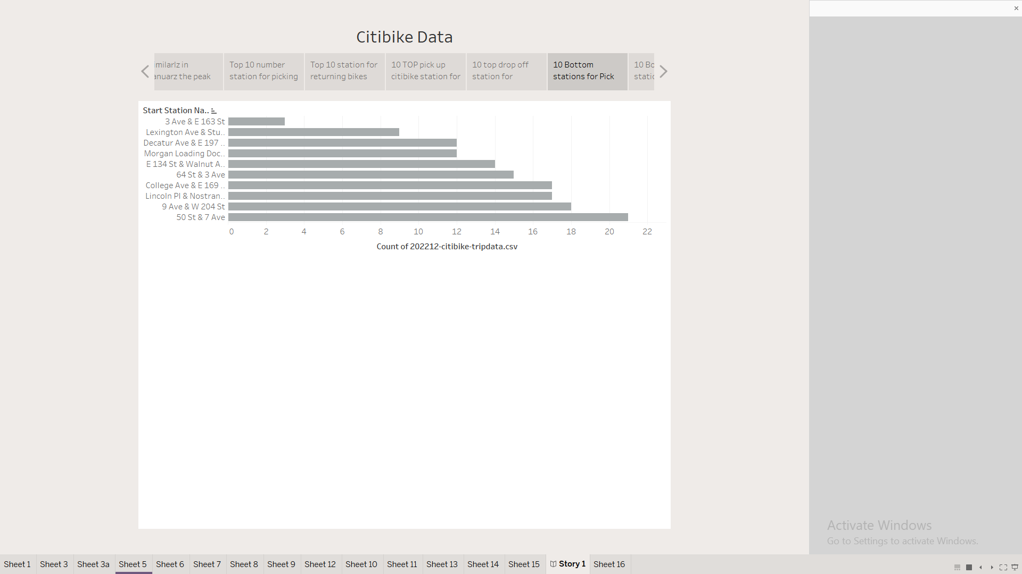

Slide 13
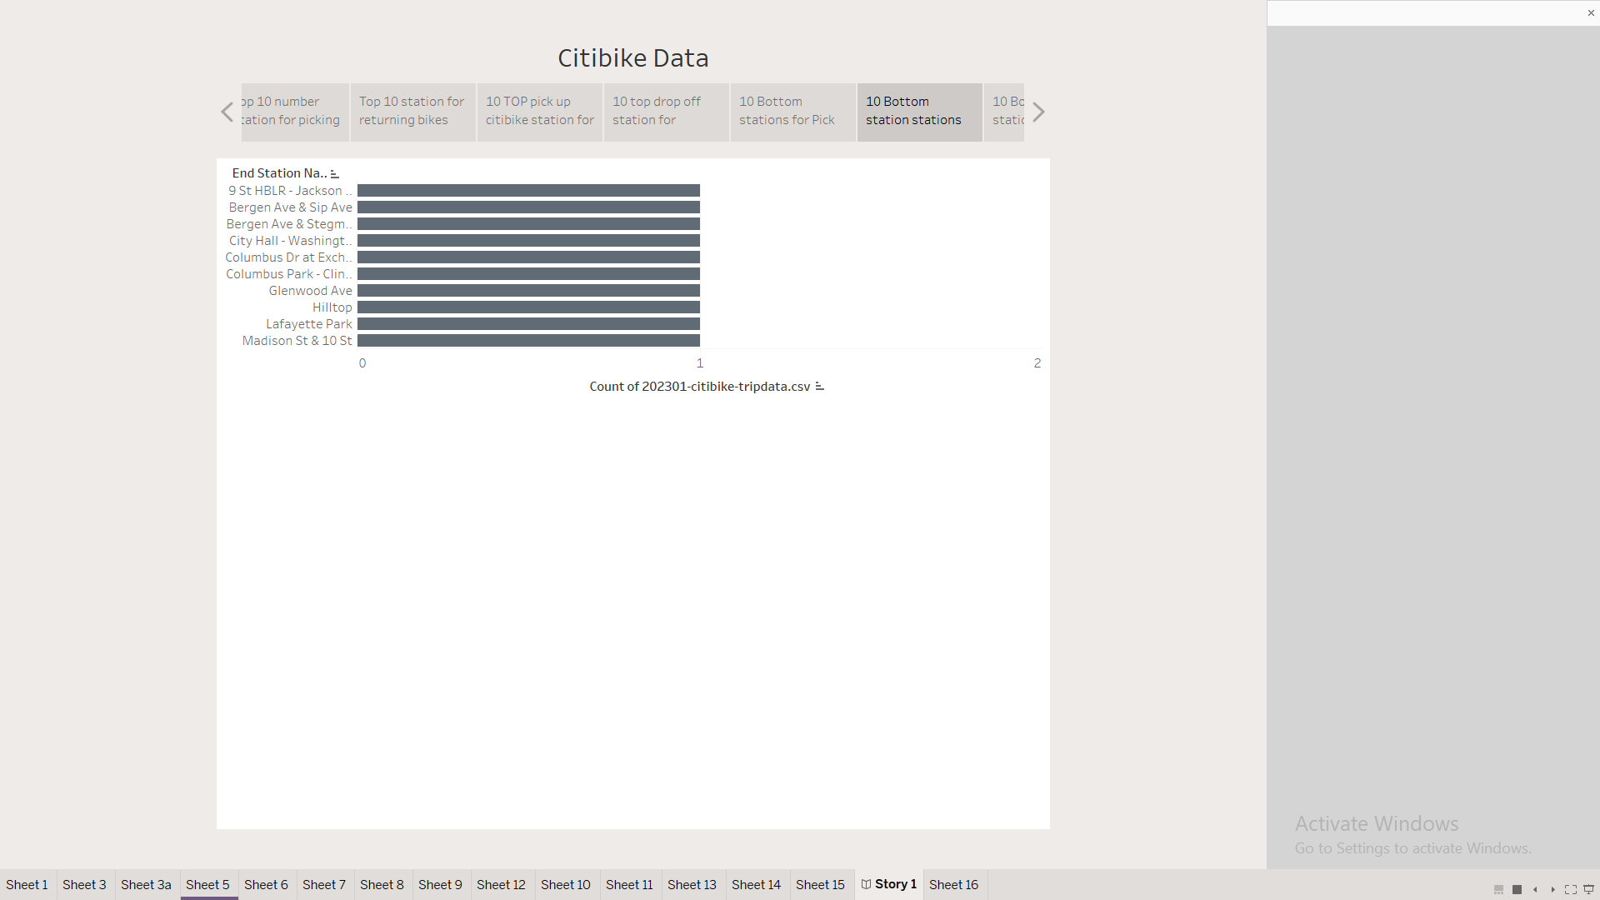

Slide 14
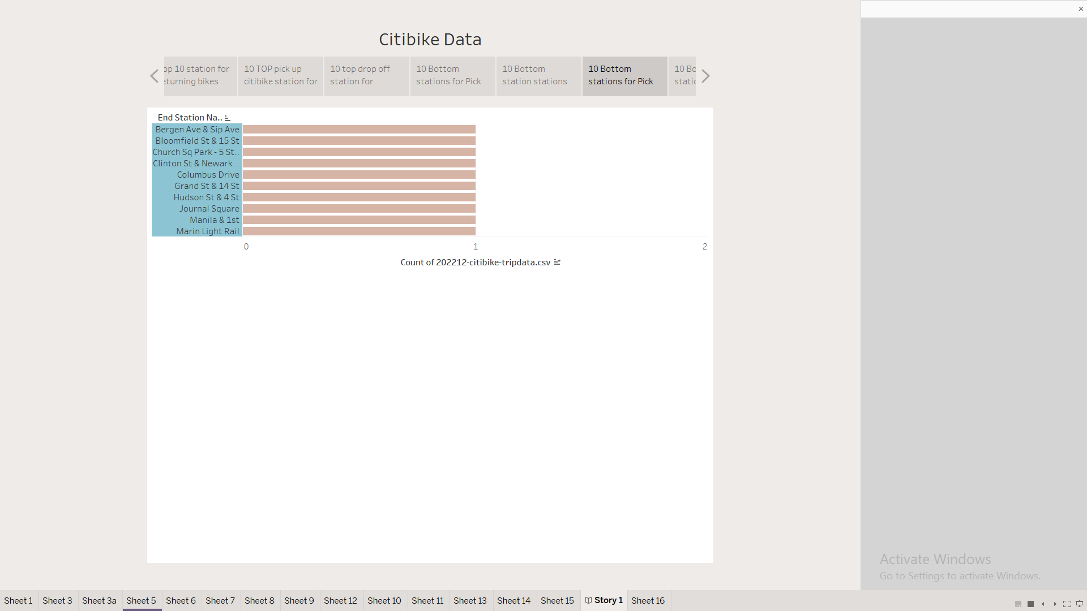

Slide 15
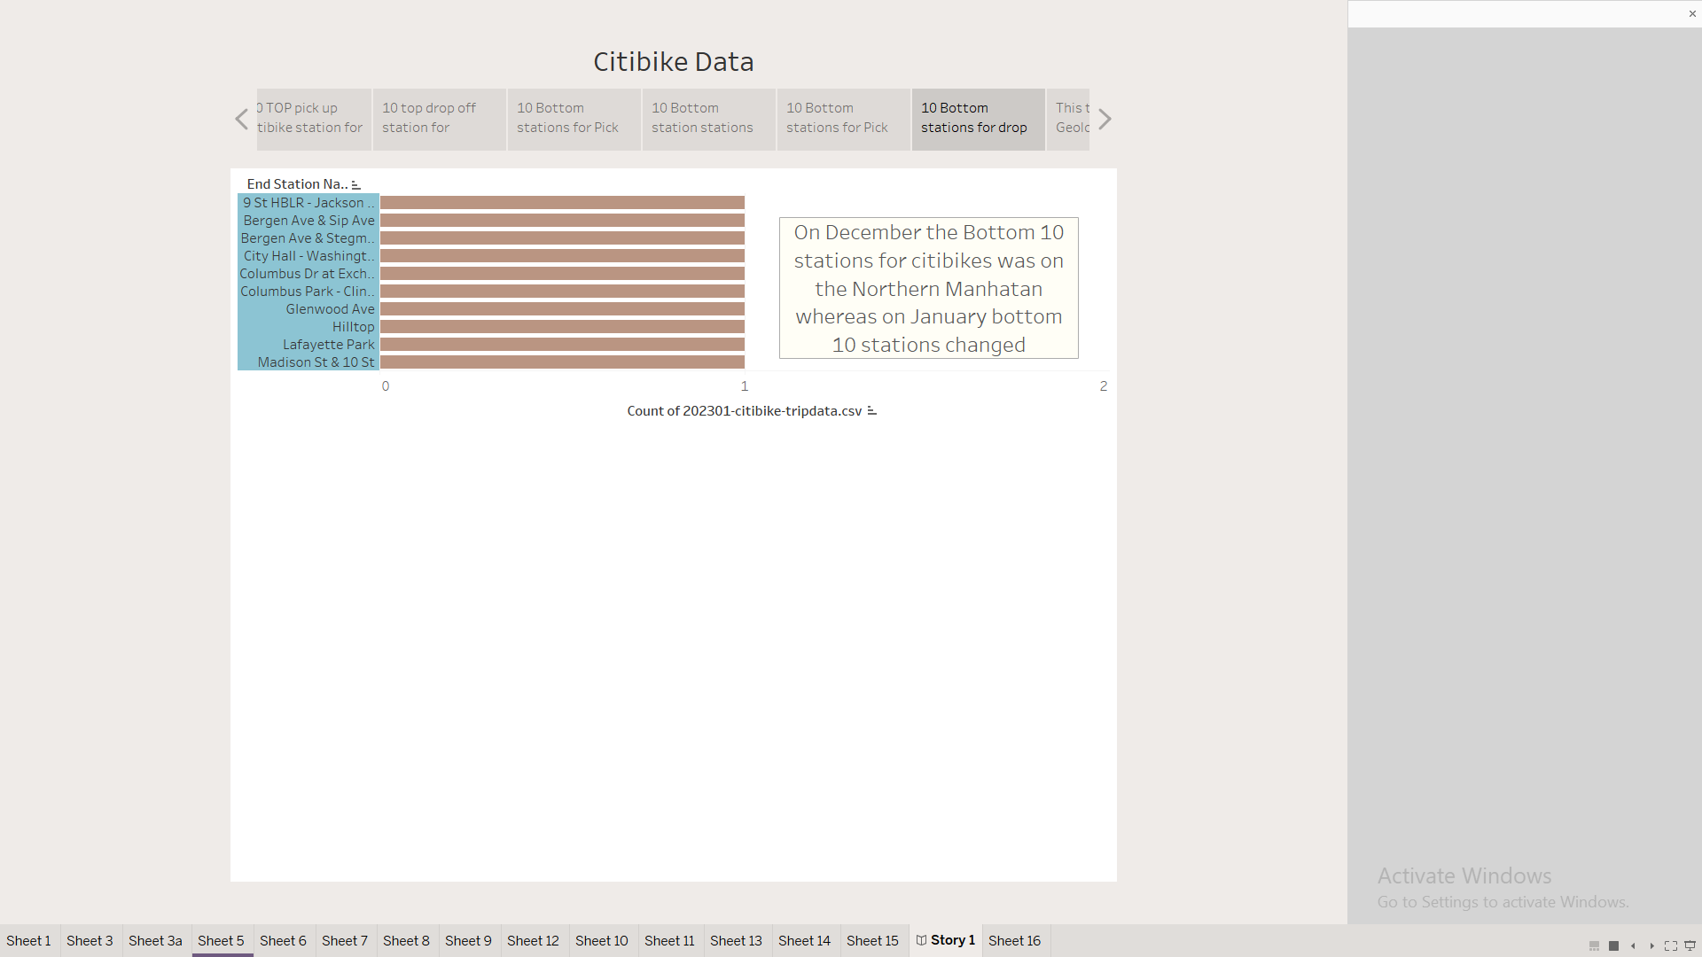

Slide 16
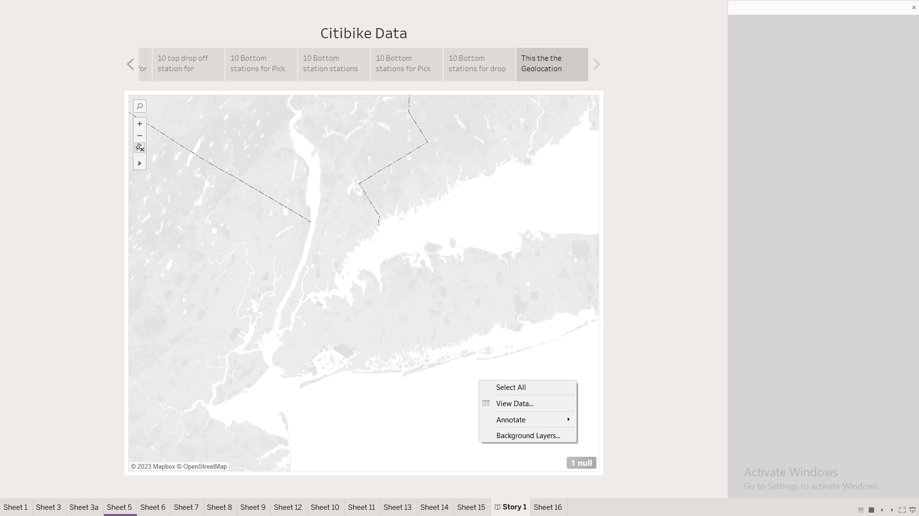
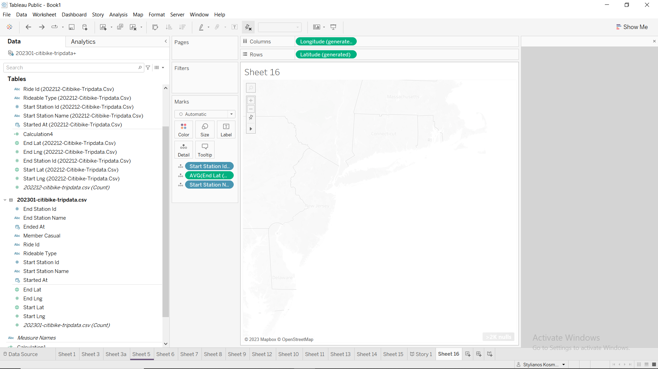
Geolocation works however due to high number of rides the map cannot be populated

